Slide 1

PiM Quick Start Guide
(Global / All Markets View)
LEARN HOW TO:
Search for Product Information & Images
Create Custom Product Data Reports
Generate PPT Sell Sheets & Data Sheets
Updated: 02.11.2016

Slide 2

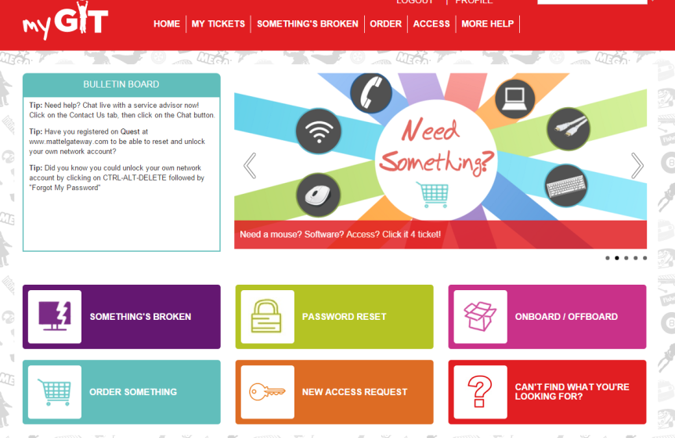
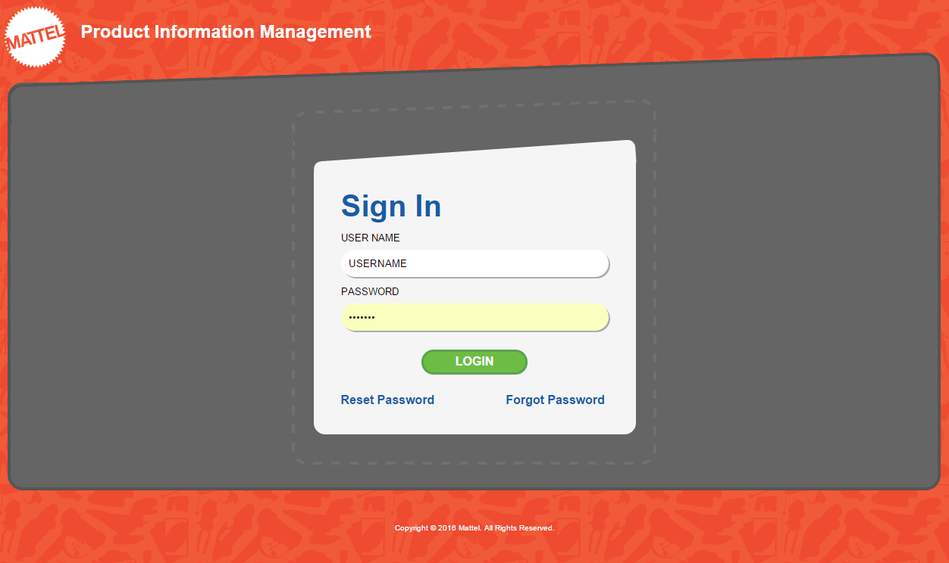
Accessing PiM: Account & Login Info
Getting a PiM Account
Log into http://mygit and click “New Access Request”
Click “Access Request for Business Application”
Click “Other Business Application”
Complete Form and Click Add to Cart. Ensure “PIM” is entered in Enterprise Application Name Field.
Your username and password will be emailed to you within 1 to 2 business days.
Logging in to PiM
Open Google Chrome browser
Enter http://pimglobal
Type in your username and password
Click the <Login> button
Google Chrome is the preferred browser

Slide 3
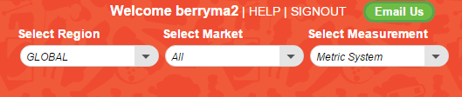
Navigating PiM: Region & Market
When you first log in to PiM, you will be defaulted to Region = GLOBAL and Market = All
The measurement system will default to Metric unless you switch to NAD / US, in which case it will default to US Customary Units. You may change the default Measurement System if you need to.
The Global / All Markets View contains all Toys and Dash Codes available across all markets, however the pricing information shown is for the US Only and is shown in US Dollars.
The Global / All Markets View should be used for those looking for standard information that does not vary by market such as measurements, weights, and out of box product images.
1
2
3

Slide 4
Using PiM: 3 Major Use Cases
Product Search Tab | Reports Tab: Excel | Reports Tab: PPT
1) Search for Product Info & Images | 2) Create Custom Product Data Reports | 3) Generate PPT Sell Sheets & Data Sheets
Less than 50 Items Search by Toy #, UPC/EAN, Product Name, or GRS Level 1-5 Quickly view and download Quoting Attributes Create one-off Sell Sheets and Data Sheets (one item at a time) Quickly view an Assortment Mix or look up where an IIA is Used For more than 50 items, use the Reports Tab | Any # of items Set up a custom filter to retrieve a group of items OR Copy & paste a list of items from Excel Items can be filtered based on Line Year, Season, GRS Level 1-7, Packaging Language etc. Choose your column headers (and order of display) from the full list of product attributes available in PiM (including images) | Any # of items Copy and paste a list of items to automatically generate PPT Sell Sheets Select Product and/or Product in Package images Show or Hide Pricing

Slide 5
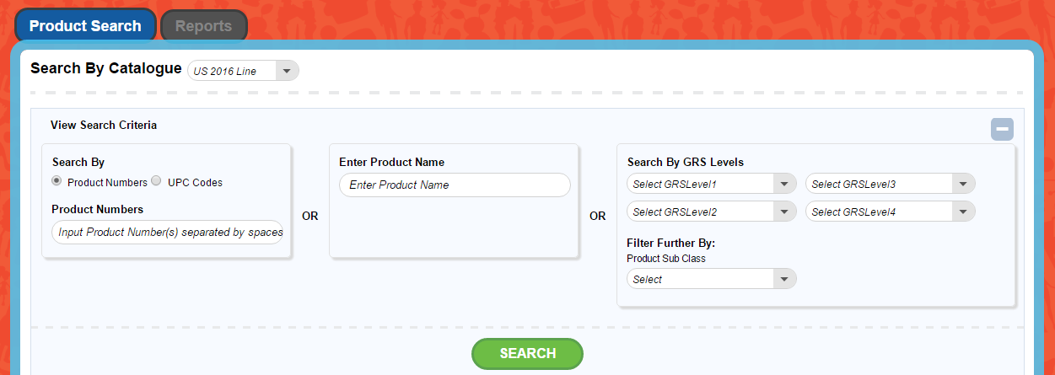

Product Search: Search for an Item
There are three ways to search for an item in PiM:
1) Search by Toy#s or UPCs
2) Search by
Product Name
3) Search by
GRS Levels
Tips & Tricks
You can copy and paste a list of Toy #s or UPCs from Excel vs. typing one by one
Product Name search checks 3 different fields for your keywords: Description, Legal Name and Working Name

Slide 6
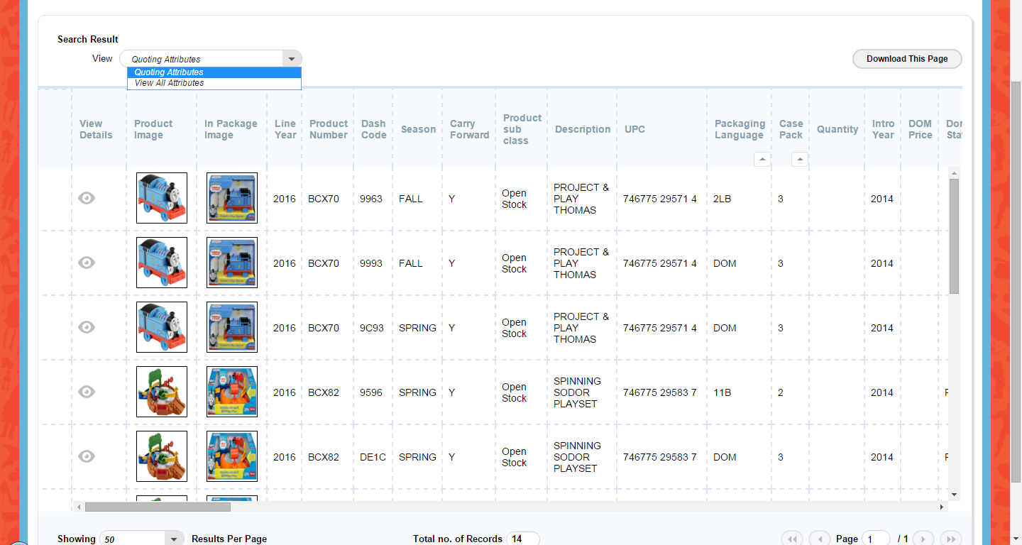
Product Search: Search Results Grid
Search results are displayed in a grid format which mimics how they will look when exported to Excel.
The default search results presents only Quoting Attributes.
Toggle the View drop down to All Attributes to show all attributes available in PiM.
Click “Download This Page” button to export the data shown on the current page
Tips & Tricks
Items will be sorted by: Toy # + Packaging Language + Case Pack
The page defaults to 10 rows of data even though more data may be available to scroll through. You can change the page to display (and download) up to 50 rows of data. To download more data, use the Reports Tab.

Slide 7

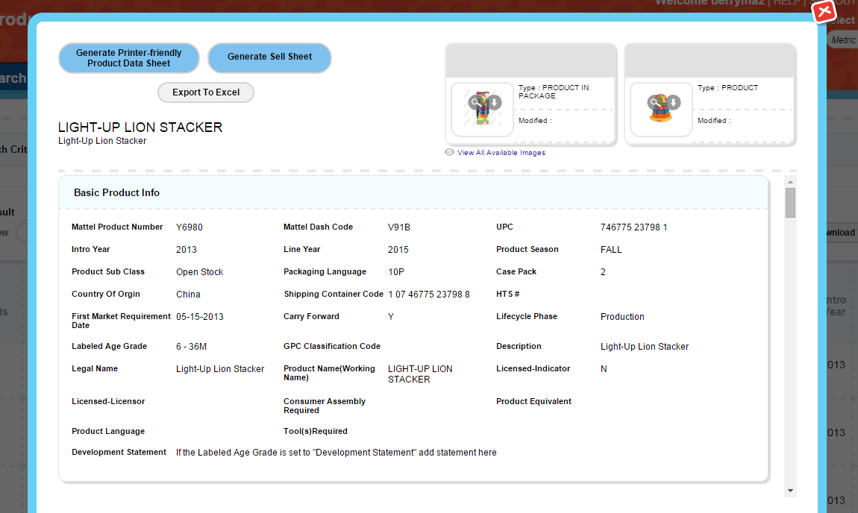
Product Search: Product Details Pop-up
To open the Product Details Pop-up, click the button (or double click the row)
From the Product Details Pop-up, you can:
  Export data to Excel
  Generate a PPT Sell Sheet or Product Data Sheet
  Click to access high res images in MAX
  For Assortments, view Items in Assortment with Quantities (Bottom of the Page)

Slide 8

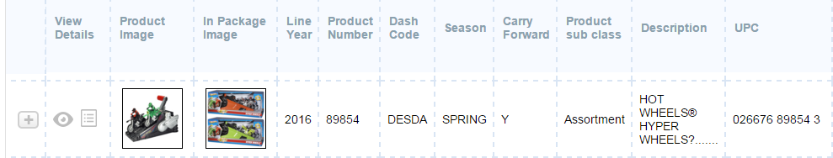
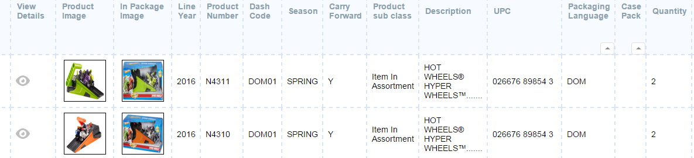
Product Search: Assortment Info
For Assortment items, you can view the Child IIAs by clicking on the on the far left
This will expand to show the IIAs along with their respective Quantities
You can also view IIA information at the bottom of the Product Details Pop-up

Slide 9

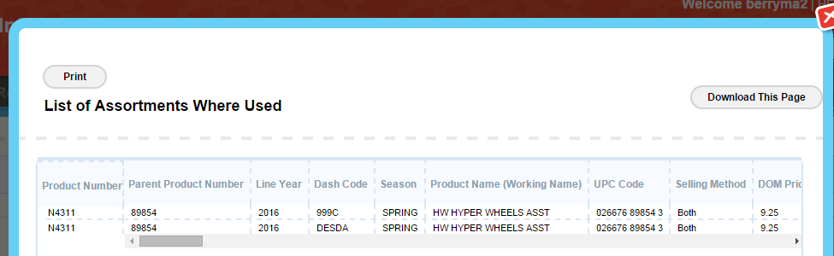
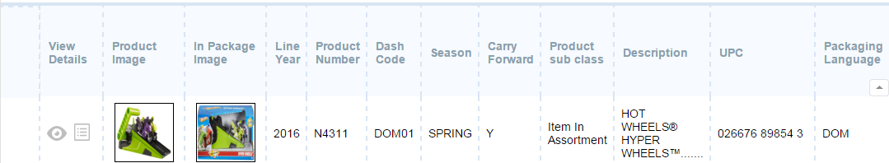
Product Search: Where IIAs are Used
For Child items, you can view the Assortments where the item is used by clicking the
This will open a pop-up which lists all Assortments the child item belong to

Slide 10
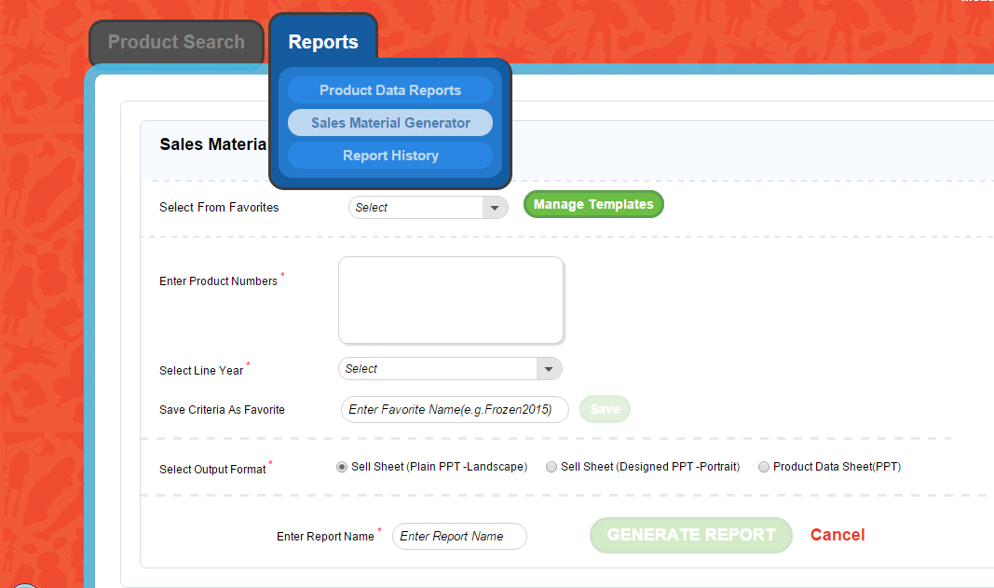
Reports: Sell Sheets & Data Sheets
From the Reports → Sales Material Generator menu, you can create three types of PowerPoints
  Sell Sheet (Landscape Layout)
  Sell Sheet (Portrait Layout)
  Product Data Sheet
Sell Sheets contain images, copy & key sales data
Data Sheets do not have images or copy, but instead show additional data (such as list of Child UPCs for Assortments)

Slide 11
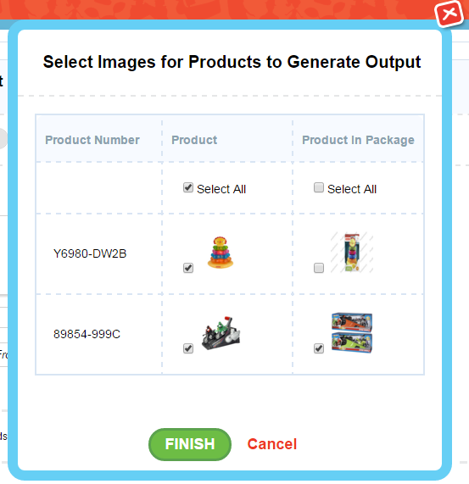
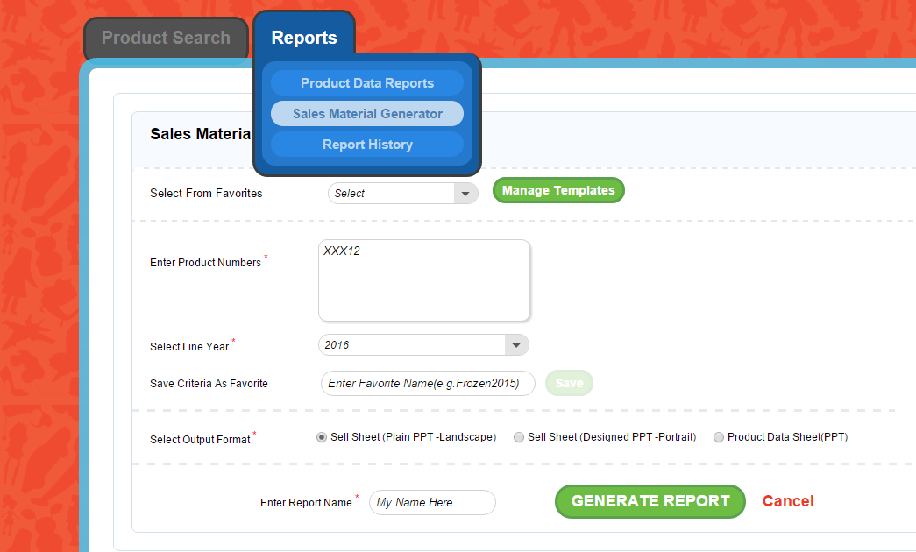
Reports: Sell Sheets & Data Sheets
To create Sales Materials: Copy and paste a list of Toy Dash numbers into the entry box, select a Line Year, choose your Sales Material Type, give the report a name and click “Generate Report”
A pop-up box will give the option of selecting a Product Image and/or Product in Package Image for each item
Make your selections and click “Finish”
You will receive an email notification when the file is ready for download from the PiM Report History section.
(Note that the email itself will not contain a copy of your report.)
6
1
2
7
3
4
5
Tips & Tricks
If you would like to hide pricing information, check the “Do Not Show Pricing on PPT” box

Slide 12
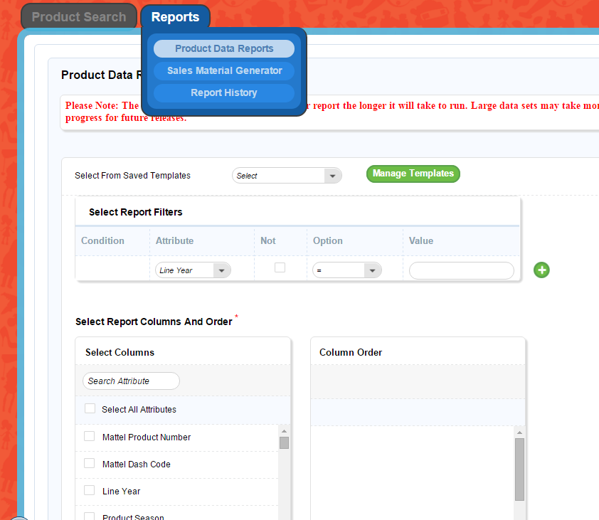
Reports: Product Data Reports
To create a Product Data Report, you will need to specify two things:
  The group of items to include in the report (e.g. All Barbie items for 2017)
  The data columns and order of display in the report (e.g. Toy #, Description, DOM Price, DI Price)
1
2

Slide 13
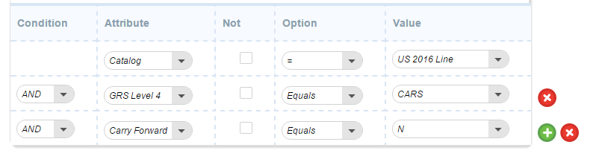
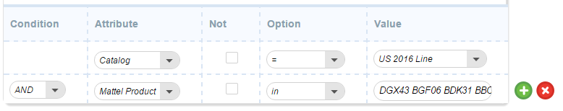
Product Data Reports: Selecting a Group of Items
The group of items to include in the report can be selected either by using the pre-defined Filters OR by entering in a specific list of Toys
Method #1: Using Filters
The first filter will always be Market + Line Year
From there, narrow down the list of items using attributes such as GRS 1-7, Carry Forward, Sub-Class, Intro Year etc.
Example: New US 2016 Cars Items
Catalog = US 2016 Line
GRS 4 = CARS
Carry Forward = No
Method #2: Entering a Specific List of Toys
The first filter will still be Market + Line Year
For the second filter, select “Mattel Product Number” from the Attribute drop down and make sure the Option is set to “in” (vs. Equals)
Next copy and paste any number of Toy #s from Excel (a space will be added automatically between each Toy #)

Slide 14
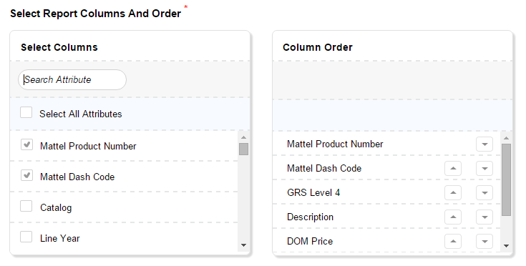

Product Data Reports: Custom Output Format
After you’ve identified the items in your report, select which pieces of data to include and in what order
All data attributes in PiM are available in the left “Select Columns” box
Click the checkbox to the left of the attribute to move it over to the right “Column Order” box (which shows the output format)
Use the up and down arrows to move the columns into your preferred order
Once you’ve finished, you will give your report a name and click the green “Generate Report” button
You will receive an email notification when the file is ready for download from the PiM Report History section. (Note that the email itself will not contain a copy of your report.)
Column A
Column B
Column C
Column D
Column E

Slide 15
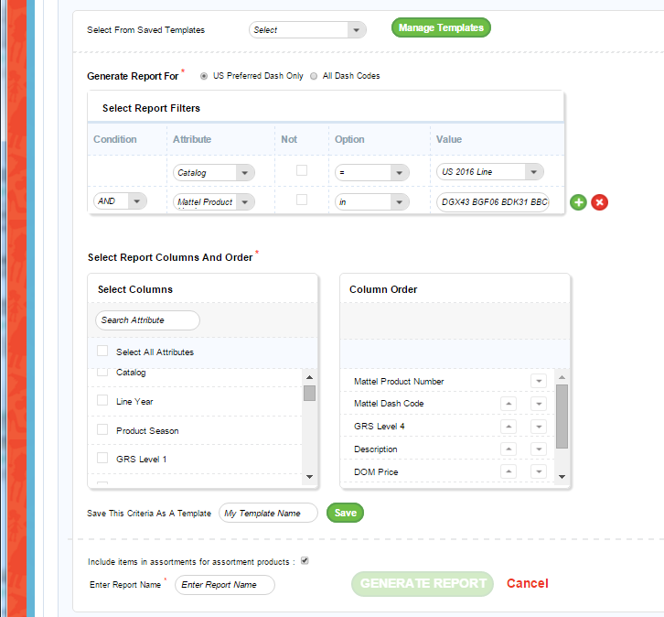

Product Data Reports: Saved Templates
You can save your filter options and output format as a template for future use by simply entering a name in the “Save This Criteria as a Template” box and clicking the green “Save” button
The template will be added to your Saved Templates list at the top of the page
To rename or delete a template, click the “Manage Templates” button at the top

Slide 16
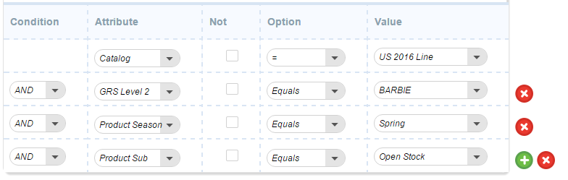
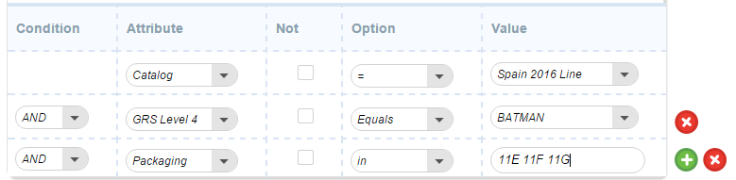
Product Data Reports: Selecting a Group of Items
More Filter Set-up Examples
Example 1: US Spring ‘16 Barbie Open Stock Items
Catalog = US 2016 Line
GRS 2 = BARBIE
Season = Spring
Sub Class = Open Stock
Example 2: Spain ‘16 Batman Items with Packaging Languages 11E, 11F, 11G
Catalog = Spain 2016 Line
GRS 4 = BATMAN
Packaging Language IN
11E 11F 11g

Slide 17
Thank You
Email: PiMTeam@Mattel.com with Questions
Updated: 02.11.2016

